Slide 1

Basics Of Java Program

Slide 2

Exam Objectives
Create an executable Java program with a main class
Compile and run a Java program from the command line
Create and import packages

Slide 3
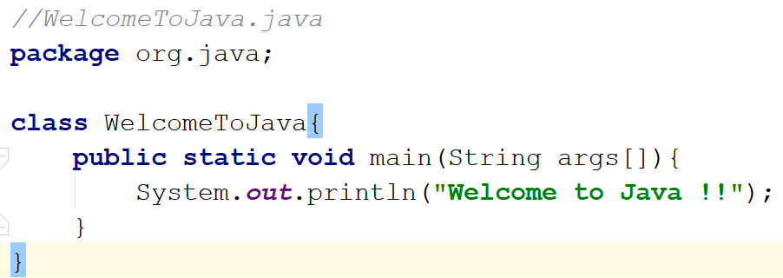
Writing the first Java program

Slide 4

Package
Example : Postal addressing system
State/District/town/locality/Postalcode/Street/House Number
Maharashtra/Pune/Chinchwad/Aundh/411007/ABC street/54-A
Package statement makes a class uniquely identifiable.
Usage package org.java
Fully qualified class name (FQCN).

Slide 5
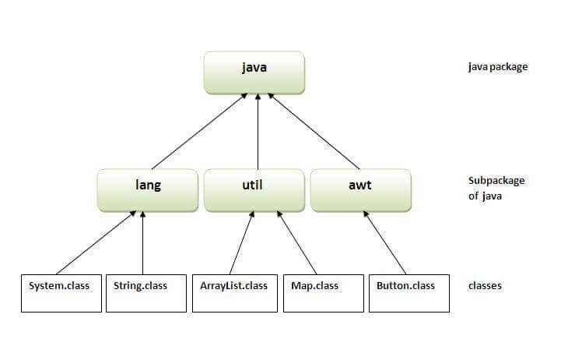
More about packages…
Package statement is the first thing to write in a java program.
Package naming convention : Reverse domain name format. This is the preferred way otherwise package name can be anything.
In order to use a java class from a different package we make use of import statement.
If two classes lie in same package then they do need to import each other .Only different package classes need to imported.
Multiple/Single file import usage.
If we don’t specify a package statement , the class is assumed to be in a default package.
Importing default package is not possible as import *;
Using fully qualified name in case of same class name.
Java.lang package in the java APIs is automatically available to all java program without explicitly importing it.
Code Examples : org/java/imports/PackageAndImports.java

Slide 6
Static Imports
The static member of a class are accessed using fully qualified class name. In cases where there is a heavy usage of static members of a class , static imports come to the rescue.
Once a class is imported statically , then we do not need to use the fully qualified name of the class. Instead we can just use the members of imported static class as they were the member of the importing class.
Ex: org.java.staticImports package.

Slide 7
Java File/Class Naming
Example : Postal addressing system

Slide 8

Entry Point to the World of JAVA : Main Method
Serves as an entry point to any java program. Almost all java programs whether it be a web server written in java or a web application or a desktop application , all begin with a main method and then extend further.
Just like a VISA document acts like an entry point to any country and you need to satisfy all the conditions in order to possess one similar is the case with main method in java.
Source Example : org.java.entrypoint.EntryPoint.java

Slide 9

Exam Perspective
We could see in the real exam , questions on a valid way of writing the entry point main method.
There are several incorrect ways of writing the entry point program.
In the exam there will be often be a case when the main method is not given.In those cases we need to assume the presence of a hidden main method.

Slide 10
Command Line Arguments
While running a java program we can pass on some input to the program.
Java reads this input in a String array.
Ways of passing command lines :
a b c
a b c
“a ” b c
In case of no arguments an array of zero size is passed.
Example : You want to write a program to display contents of a file that runner of the program wants.The runner of the program would just pass the name of the file that he wants to be displayed on command line and the program would display it.
a b c
a b c

Slide 11
Compiling & Running
In the beginning it is important to understand the semantics of running a java program from command line.
Refrain from using any IDE for some time.
Javac & java are the two tools that JDK provides to compile and execute your program respectively.
javac WelcomeToJava.java creates WelcomeToJava.class file.
Java WelcomeToJava runs the program.
Package declaration is not just a logical segregation but physical also.
Format for running a java program : java <packageName>.<MainClassName>
a b c

Slide 12

Questions ??
a b c

